Slide 1
Python Introduction
S1 MCA

Slide 2
INTRODUCTION
Python is a high-level, interpreted programming language that is:
🧠 Easy to learn and use
📝 Readable and clear syntax
🔁 Cross-platform (runs on Windows, macOS, Linux)
🚀 Used for web development, automation, data science, AI, game development, scripting, and more

Slide 3
Features in Python
Free and Open Source:
Python language is freely available at the official website. Since it is open-source, this means that source code is also available to the public. So you can download it, use it as well as share it.
Easy to code:
Python is a high-level programming language. Python is very easy to learn the language as compared to other languages like C, C#, Javascript, Java, etc. It is very easy to code in the Python language and anybody can learn Python basics in a few hours or days. It is also a developer-friendly language.
Easy to Read:
As you will see, learning Python is quite simple. As was already established, Python's syntax is really straightforward. The code block is defined by the indentations rather than by semicolons or brackets.

Slide 4
Object-Oriented Language
One of the key features of python is Object-Oriented Programming. Python supports object-oriented language and concepts of classes, object encapsulation, etc.
GUI Programming Support
Graphical User interfaces can be made using a module such as pyQt5, PyQt4, wxPython, or Tk in Python. PyQt5 is the most popular option for creating graphical apps with Python.
High-Level Language
Python is a high-level language. When we write programs in Python, we do not need to remember the system architecture, nor do we need to manage the memory.
Large Community Support
Python has gained popularity over the years. questions are constantly answered by the enormous StackOverflow community. These websites have already provided answers to many questions about Python, so Python users can consult them as needed.

Slide 5
Easy to Debug
Excellent information for mistake tracing. You will be able to quickly identify and correct the majority of your program's issues once you understand how to interpret Python's error traces. Simply by glancing at the code, you can determine what it is designed to perform.
Python is a Portable language
Python language is also a portable language. For example, if we have Python code for Windows and if we want to run this code on other platforms such as Linux, Unix, and Mac then we do not need to change it, we can run this code on any platform.
Python is an Integrated language
Python is also an Integrated language because we can easily integrate Python with other languages like C, C++, etc.
Interpreted Language:
Python is an Interpreted Language because Python code is executed line by line at a time. like other languages C, C++, Java etc. there is no need to compile Python code this makes it easier to debug our code. The source code of Python is converted into an immediate form called bytecode.

Slide 6
Large Standard Library
Python has a large standard Library that provides a rich set of modules and functions so you do not have to write your own code for every single thing.
Dynamically Typed Language
Python is a dynamically-typed language. That means the type (for example- int, double, long, etc.) for a variable is decided at run time not in advance because of this feature we don't need to specify the type of variable.
Frontend and backend development
With a new project py script, you can run and write Python codes in HTML with the help of some simple tags <py-script>, <py-env>, etc. This will help you do frontend development work in Python like javascript. Backend is the strong forte of Python it's extensively used for this work cause of its frameworks like Django and Flask.
Allocating Memory Dynamically
In Python, the variable data type does not need to be specified. The memory is automatically allocated to a variable at runtime when it is given a value. Developers do not need to write int y = 18 if the integer value 15 is set to y. You may just type y=18.

Slide 7
Python Install
Many PCs and Macs will have python already installed.
To check if you have python installed on a Windows PC, search in the start bar for Python or run the following on the Command Line (cmd.exe):
C:\Users\Your Name>python --version
To check if you have python installed on a Linux or Mac, then on linux open the command line or on Mac open the Terminal and type:
python --version

Slide 8
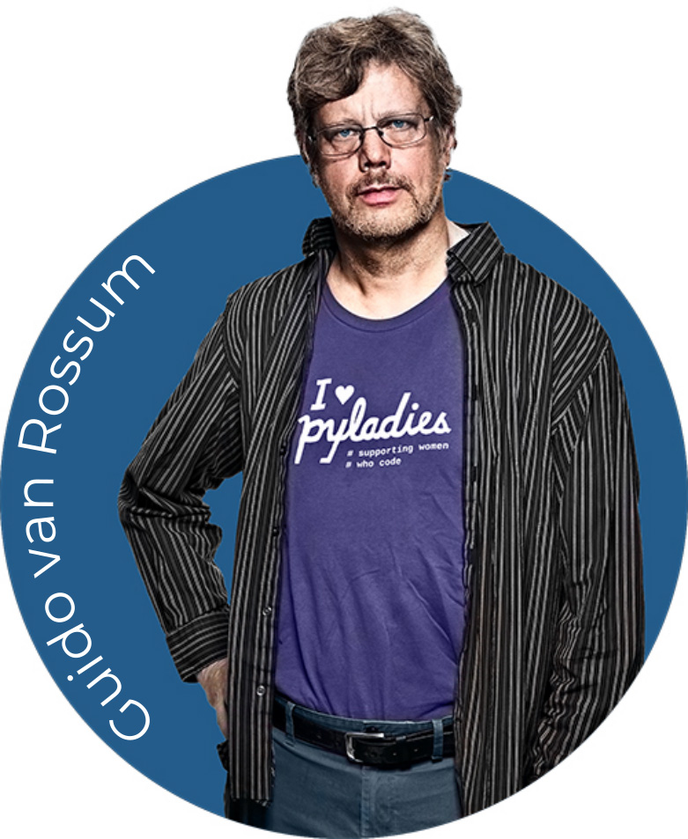
FOUNDER

Slide 9
Python Keywords and Identifiers
Keywords in Python
Python Keywords are some predefined and reserved words in Python that have special meanings. Keywords are used to define the syntax of the coding. The keyword cannot be used as an identifier, function, or variable name. All the keywords in Python are written in lowercase except True and False.
# code for list all keywords
import keyword
print(keyword.kwlist)
['False', 'None', 'True', 'and', 'as', 'assert', 'async', 'await', 'break', 'class', 'continue', 'def', 'del', 'elif', 'else', 'except', 'finally', 'for', 'from', 'global', 'if', 'import', 'in', 'is',...]

Slide 10
Identifiers in Python
Identifier is a user-defined name given to a variable, function, class, module, etc. The identifier is a combination of character digits and an underscore. They are case-sensitive i.e., 'num' and 'Num' and 'NUM' are three different identifiers in python. It is a good programming practice to give meaningful names to identifiers to make the code understandable.
Rules for Naming Python Identifiers
It cannot be a reserved python keyword.
It should not contain white space.
It can be a combination of A-Z, a-z, 0-9, or underscore.
It should start with an alphabet character or an underscore ( _ ).
It should not contain any special character other than an underscore ( _ ).

Slide 11
Valid identifiers:
var1
_var1
_1_var
var_1
Invalid Identifiers
!var1
1var
1_var
var#1
var 1

Slide 12
Python Indentation
Indentation refers to the spaces at the beginning of a code line.
Where in other programming languages the indentation in code is for readability only, the indentation in Python is very important.
Python uses indentation to indicate a block of code.
✅
if 5 > 2: print("Five is greater than two!")
❌
if 5 > 2: print("Five is greater than two!")

Slide 13
✅The number of spaces is up to you as a programmer, the most common use is four, but it has to be at least one.
if 5 > 2: print("Five is greater than two!") if 5 > 2: print("Five is greater than two!")
❌You have to use the same number of spaces in the same block of code, otherwise Python will give you an error☺
if 5 > 2: print("Five is greater than two!") print("Five is greater than two!")

Slide 14
Comments
Python has commenting capability for the purpose of in-code documentation.
Comments start with a #, and Python will render the rest of the line as a comment
Comments can be used to explain Python code.
Comments can be used to make the code more readable.
Comments can be used to prevent execution when testing code.
EX:
print("Hello, World!") #This is a comment
#print("Hello, World!") print("Cheers, Mate!")

Slide 15
Multiline Comments
Since Python will ignore string literals that are not assigned to a variable, you can add a multiline string (triple quotes) in your code, and place your comment inside it.
""" This is a comment written in more than just one line """ print("Hello, World!")

Slide 16
Variables in Python
Variables are reserved memory locations to store values.
Python has no command for declaring a variable.
A variable is created the moment you first assign a value to it. This means that when you create a variable thr interpreter allocate memory and memory and what can be stored in the reserved memory.
Based on the data type of a variable, memory space is allocated to it. Therefore, by assigning different data types to Python variables, you can store integers, decimals or characters in these variables.
the equal(=) sign is used to assign value to varables.

Slide 17
Ex:
printing variables
counter = 100 # Creates an integer variable
miles = 1000.0 # Creates a floating point variable
name = "Zara Ali" # Creates a string variable
print (counter)
print (miles)
print (name)
Output:
100
1000.0
Zara Ali

Slide 18
Deleting Python Variables
You can delete the reference to a number object by using the del statement. The syntax of the del statement is
syntax: del var1,var2,var3....,varN
EX:
counter = 100
print (counter)
del counter
print (counter)
Traceback (most recent call last):
File "main.py", line 7, in <module>
print (counter)
NameError: name 'counter' is not defined

Slide 19
Getting Type of a Variable
You can get the data type of a Python variable using the python built-in function type() as follows.
x = "Zara"
y = 10
z = 10.10
print(type(x))
print(type(y))
print(type(z))
This will produce the following result:
<class 'str'>
<class 'int'>
<class 'float'>

Slide 20
Multi Words Variable Names
Camel Case
Each word, except the first, starts with a capital letter:
myVariableName = "John"
Pascal Case
Each word starts with a capital letter:
MyVariableName = "John"
Snake Case
Each word is separated by an underscore character:
my_variable_name = "John"

Slide 21
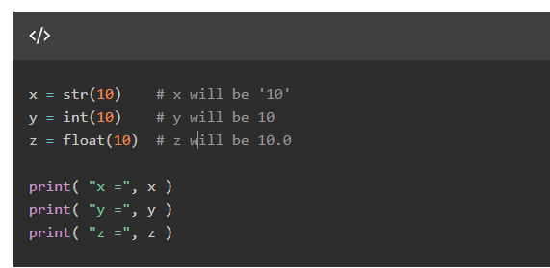

Casting Python Variables
Type casting is the process of converting one data type into another.
You can specify the data type of a variable with the help of casting as follows:

Slide 22
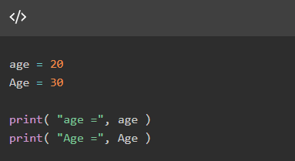

Case-Sensitivity of Python Variables
Python variables are case sensitive which means Age and age are two different variables:

Slide 23


Python Variables - Multiple Assignment
Python allows to initialize more than one variables in a single statement. In the following case, three variables have same value.
Instead of separate assignments, you can do it in a single assignment statement as follows −

Slide 24


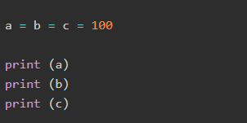

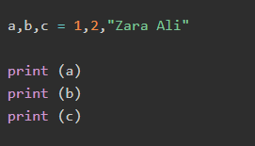


Slide 25
String variables can be declared either by using single or double quotes:
x = "John" # is the same as x = 'John’
Unpack a Collection
If you have a collection of values in a list, tuple etc. Python allows you to extract the values into variables. This is called unpacking.
fruits = ["apple", "banana", "cherry"] x, y, z = fruits print(x) print(y) print(z)

Slide 26
OUTPUT VARIABLE
The Python print() function is often used to output variables.
Example:
x = "Python is awesome" print(x)
In the print() function, you output multiple variables, separated by a comma:
Example
x = "Python"
y = "is"
z = "awesome"
print(x, y, z)

Slide 27
You can also use the + operator to output multiple variables:
x = "Python "
y = "is "
z = "awesome"
print(x + y + z)
Notice the space character after "Python " and "is ", without them the result would be "Pythonisawesome".
For numbers, the + character works as a mathematical operator:
x = 5
y = 10
print(x + y)

Slide 28
In the print() function, when you try to combine a string and a number with the + operator, Python will give you an error:
x = 5
y = "John"
print(x + y)
The best way to output multiple variables in the print() function is to separate them with commas, which even support different data types:
x = 5
y = "John"
print(x, y)

Slide 29
Python - Global Variables
Variables that are created outside of a function (as in all of the examples in the previous pages) are known as global variables.
Global variables can be used by everyone, both inside of functions and outside.
x = "awesome" def myfunc(): print("Python is " + x) myfunc()

Slide 30
If you create a variable with the same name inside a function, this variable will be local, and can only be used inside the function. The global variable with the same name will remain as it was, global and with the original value.
x = "awesome" def myfunc(): x = "fantastic" print("Python is " + x) myfunc() print("Python is " + x)

Slide 31
The global Keyword
Normally, when you create a variable inside a function, that variable is local, and can only be used inside that function.
To create a global variable inside a function, you can use the global keyword.
If you use the global keyword, the variable belongs to the global scope:
def myfunc():
global x
x = "fantastic"
myfunc()
print("Python is " + x)

Slide 32
Also, use the global keyword if you want to change a global variable inside a function.
Example
To change the value of a global variable inside a function, refer to the variable by using the global keyword:
x = "awesome"
def myfunc():
global x
x = "fantastic"
myfunc()
print("Python is " + x)

Slide 33
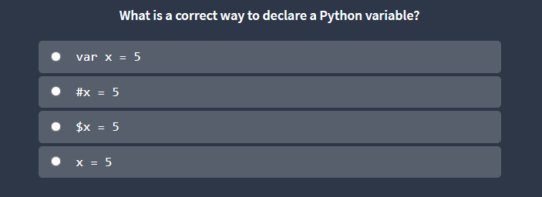
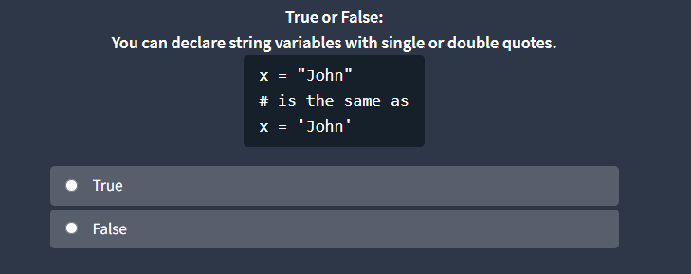

Slide 34
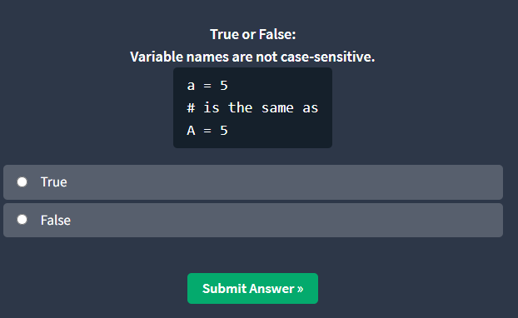
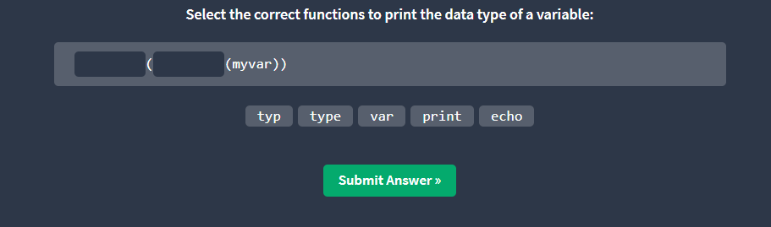

Slide 35
INPUT Function
Reading the Input
python provides built in functions to read a line of text from standard input those are
raw_input
input
raw_input Function:
syntax -> raw_input([your input])
This prompt allow you to enter the string and display the same string while print
str =raw_input(“Enter Name:”)
print(“Name:”,str)

Slide 36
output:
Enter Name: Albin
Name: Albin
Input Function:
syntax: input([Enter Prompt])
This fuction will assume the input as a valid python expresion and returns the evaluated result
val1 = raw_input("Enter the name: ")
print(type(val1))
print(val1)
val2 = raw_input("Enter the number: ")
print(type(val2))

Slide 37
Python Numbers
There are three numeric types in Python:
int
float
Complex
To verify the type of any object in Python, use the type() function:

Slide 38
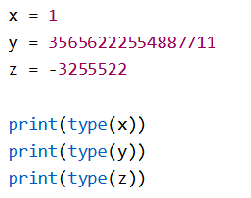
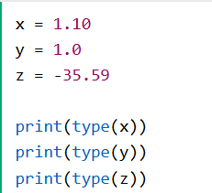
Int
Int, or integer, is a whole number, positive or negative, without decimals, of unlimited length.
Float
Float
Float
Float, or "floating point number" is a number, positive or negative, containing one or more decimals.

Slide 39
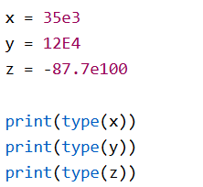
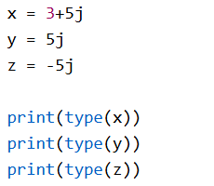
Float can also be scientific numbers with an "e" to indicate the power of 10.
Complex
Complex numbers are written with a "j" as the imaginary part:

Slide 40
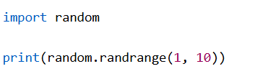
Random Number
Python does not have a random() function to make a random number, but Python has a built-in module called random that can be used to make random numbers:

Slide 41
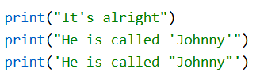
Python Strings
Strings in python are surrounded by either single quotation marks, or double quotation marks.
'hello' is the same as "hello“
Quotes Inside Quotes
Assign String to a Variable
a = "Hello" print(a)

Slide 42
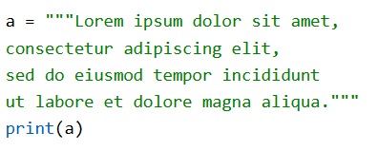
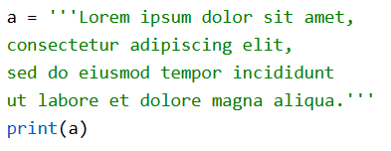
Multiline Strings
You can assign a multiline string to a variable by using three quotes:

Slide 43
Strings are Arrays
Like many other popular programming languages, strings in Python are arrays of unicode characters.
However, Python does not have a character data type, a single character is simply a string with a length of 1.
Square brackets can be used to access elements of the string.
a = "Hello, World!" print(a[1])

Slide 44
Looping Through a String
Since strings are arrays, we can loop through the characters in a string, with a for loop.
>>>for x in "banana": print(x)
String Length
To get the length of a string, use the len() function.

Slide 45

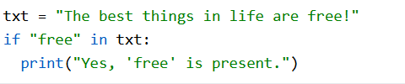

Check String
To check if a certain phrase or character is present in a string, we can use the keyword in.
Use it in an if statement:
Check if NOT
To check if a certain phrase or character is NOT present in a string, we can use the keyword not in.

Slide 46
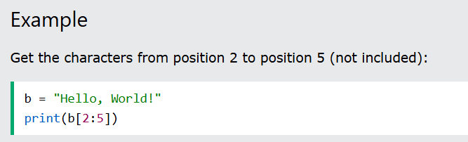
Python - Slicing Strings
Slicing
You can return a range of characters by using the slice syntax.
Specify the start index and the end index, separated by a colon, to return a part of the string.
The first character has index 0.

Slide 47
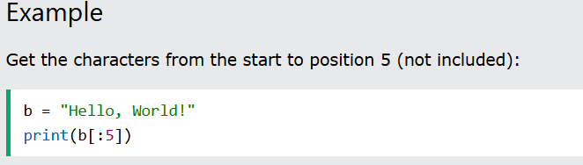
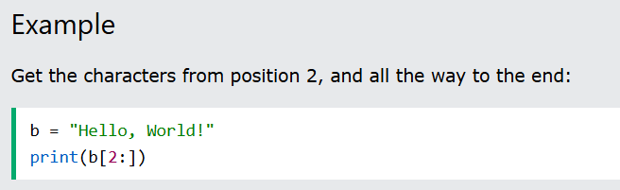
Slice From the Start
By leaving out the start index, the range will start at the first character:
Slice To the End
By leaving out the end index, the range will go to the end:

Slide 48
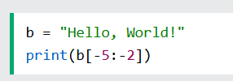
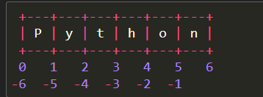
Negative Indexing
Use negative indexes to start the slice from the end of the string:
Get the characters:
From: "o" in "World!" (position -5)
To, but not included: "d" in "World!" (position -2):

Slide 49




Python - Modify Strings
The upper() method returns the string in upper case:
The lower() method returns the string in lower case:
The strip() method removes any whitespace from the beginning or the end:
The replace() method replaces a string with another string:

Slide 50
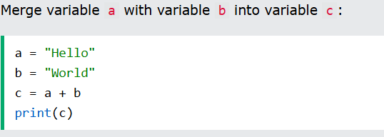
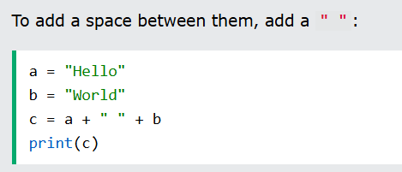
Python - String Concatenation
To concatenate, or combine, two strings you can use the + operator.

Slide 51
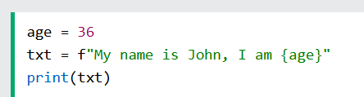
Python - Format - Strings
we can combine strings and numbers by using f-strings or the format() method!
F-Strings:
F-String was introduced in Python 3.6, and is now the preferred way of formatting strings. To specify a string as an f-string, simply put an f in front of the string literal, and add curly brackets {} as placeholders for variables and other operations.

Slide 52

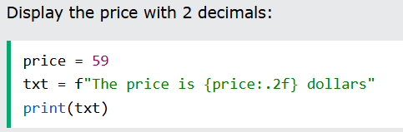
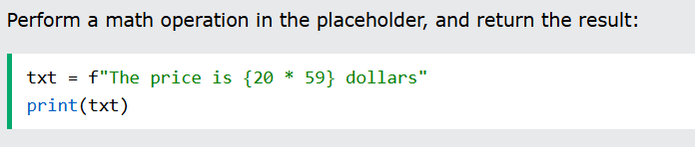
Placeholders and Modifiers
A placeholder can contain variables, operations, functions, and modifiers to format the value.
A placeholder can include a modifier to format the value.
A modifier is included by adding a colon : followed by a legal formatting type, like .2f which means fixed point number with 2 decimals:
A placeholder can contain Python code, like math operations:

Slide 53
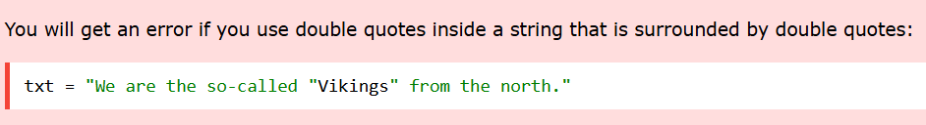
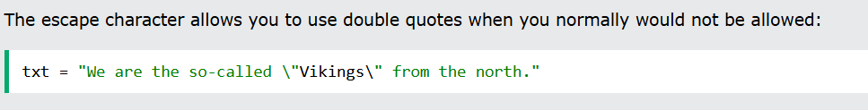
Python - Escape Characters
To insert characters that are illegal in a string, use an escape character.
An escape character is a backslash \ followed by the character you want to insert.
An example of an illegal character is a double quote inside a string that is surrounded by double quotes:
To fix this problem, use the escape character \":

Slide 54
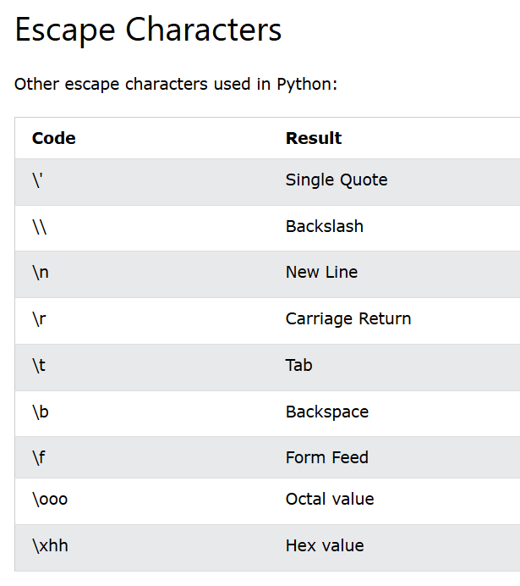

Slide 55
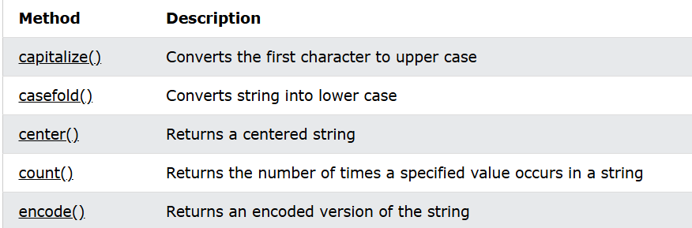
Python - String Methods
Python has a set of built-in methods that you can use on strings.
ASSIGNMENT
Method | Description | EX

Slide 56
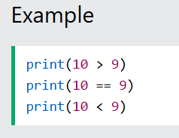
Python Booleans
Booleans represent one of two values: True or False. You can evaluate any expression in Python, and get one of two answers, True or False.

Slide 57
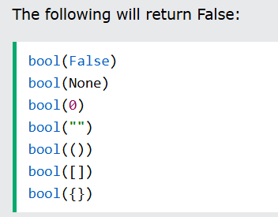
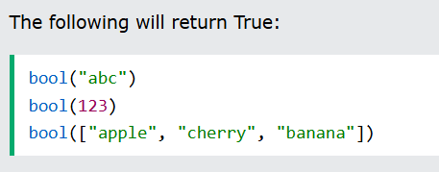
Evaluate Values and Variables
The bool() function allows you to evaluate any value, and give you True or False in return,
Almost any value is evaluated to True if it has some sort of content.
Any string is True, except empty strings.
Any number is True, except 0.
Any list, tuple, set, and dictionary are True, except empty ones.
In fact, there are not many values that evaluate to False, except empty values, such as (), [], {}, "", the number 0, and the value None. And of course the value False evaluates to False.

